Slide 1

Y11 Independent Study Strategies
Supporting self-regulative learners
PLAN MONITOR EVALUATE

Slide 2
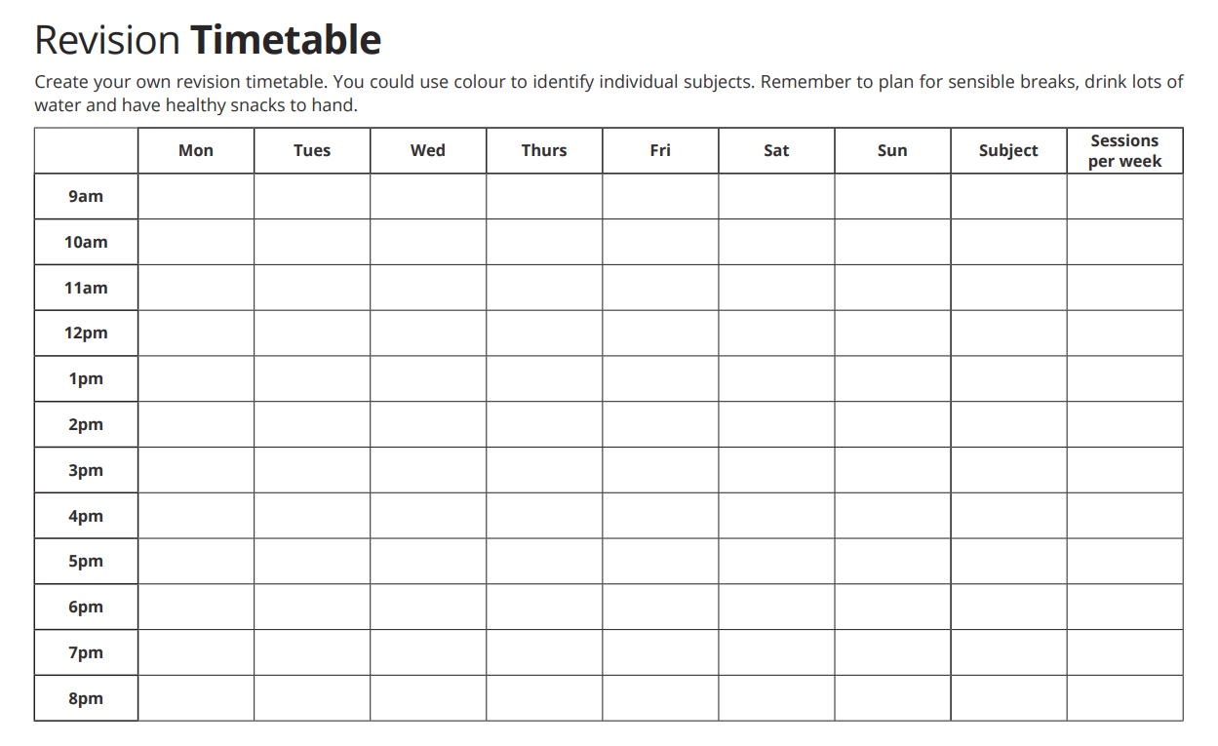

Slide 3
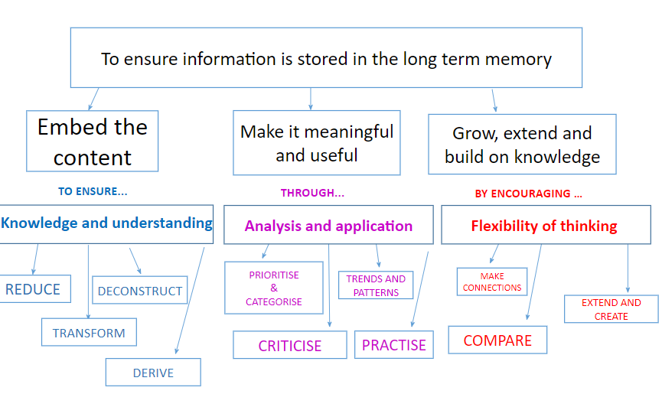

Slide 4
Knowledge and Understanding
Reduce
Transform
Deconstruct
Derive

Slide 5

Reduce it
Key Argument:
________________________________________________________________________________________________________________________________________________________________________________________________________________________________________________________________________________________
Reduce the key argument in today’s lesson into 12 words.

Slide 6
Reduce it
__________________________________________________________
__________________________________________________________
__________________________________________________________
__________________________________________________________
__________________________________________________________
Sum up your last piece of work into 5 bullet points.

Slide 7
Reduce it
___________________________________________________________________________
___________________________________________________________________________
___________________________________________________________________________
Sum up the content of todays lesson into three key words and justify why you have chosen them.

Slide 8
Reduce it
___________________________________________________________________________
___________________________________________________________________________
___________________________________________________________________________
Write 3 questions that the lesson so far has answered.

Slide 9

Transform it
Transform the last piece of work you did into a mindmap.

Slide 10
Transform it
Transform the last piece of work you did into a picture.

Slide 11
Transform it
____________________________________________________________________________________________________________________________________________________________________________________________________________________________________________________________________________________________________________________
Transform the last piece of work you did into a piece of poetry.

Slide 12

Deconstruct it
Title:
____________________________________________________________________________________________________________________________________________________________________________________________________________________________________________________________
Now that you have some new information, write the title in the box and deconstruct it. From the title and new information, tell us what the lesson is about.

Slide 13
Deconstruct it
Exam Question:
____________________________________________________________________________________________________________________________________________________________________________________________________________________________________________________________
Now that you have answered an exam question, deconstruct the actual question.
What does it want you to do?
What should your answer be about?

Slide 14

Derive it
____________________________________________________________________________________________________________________________________________________________________________________________________________________________________________________________________________________________________________________
Have a look at one of the pictures on your worksheet/board. What is happening, how is it good/bad?

Slide 15
Analysis and Application
Prioritise
Categorise
Criticise
Trends and patterns
Practice

Slide 16

Prioritise it
___________________________________________________________________________
___________________________________________________________________________
___________________________________________________________________________
Prioritise the knowledge you have learnt today.
From most important to least important.

Slide 17
Derive it
____________________________________________________________________________________________________________________________________________________________________________________________________________________________________________________________________________________________________________________
Out of today’s lesson, what was the most important thing you’ve learnt and why?

Slide 18

Categorise it
____________________________________________________________________________________________________________________________________________________________________________________________________________________________________________________________________________________________________________________
What have you learnt today?
How will it affect people (social), money (economic) and the environment?

Slide 19
Categorise it
____________________________________________________________________________________________________________________________________________________________________________________________________________________________________________________________________________________________________________________
What have you learnt today?
How is it good?
How is it bad?

Slide 20

Criticise it
What did your peer say?
________________________________________________________________________________________________________________________________________________________________________________________________________________________________
Ask a peer for the most important knowledge from today’s lessons.
Criticise what they said and why it is not the most important.

Slide 21

Practice it
Exam Question:
____________________________________________________________________________________________________________________________________________________________________________________________________________________________________________________________________________________________________________________
Write your own exam question based on today’s lessons.
Answer it.

Slide 22
Flexibility of thinking
Make connections
Compare
Extend
Create

Slide 23

Connect it
Write down 4 key words from today’s lesson.
Connect them to each other using lines and say why they connect along the line.

Slide 24
Connect it
____________________________________________________________________________________________________________________________________________________________________________________________________________________________________________________________________________________________________________________
How does the learning in this lesson link to what you learnt in the last lesson?

Slide 25
Connect it
____________________________________________________________________________________________________________________________________________________________________________________________________________________________________________________________________________________________________________________
How does today’s lesson link to another topic we have studied this year?

Slide 26
Connect it
____________________________________________________________________________________________________________________________________________________________________________________________________________________________________________________________________________________________________________________
Describe where you might use today’s knowledge in another subject.

Slide 27

Compare it
____________________________________________________________________________________________________________________________________________________________________________________________________________________________________________________________________________________________________________________
Compare the most interesting knowledge you have learnt today with your peers most interesting knowledge.

Slide 28
Compare it
____________________________________________________________________________________________________________________________________________________________________________________________________________________________________________________________________________________________________________________
Compare two things from today’s lesson.

Slide 29

Extend it
Key words:
____________________________________________________________________________________________________________________________________________________________________________________________________________________________________________________________________________________________________________________
Write down 3 key words from today’s lesson.
Then write about the importance of those key words.

Slide 30
Extend it
Peers Sentence:
____________________________________________________________________________________________________________________________________________________________________________________________________________________________________________________________________________________________________________________
Get your peer to write a sentence about what they have learnt today.
Explain why it was important for them to know that.

Slide 31
Extend it
Title of today’s lesson:
____________________________________________________________________________________________________________________________________________________________________________________________________________________________________________________________________________________________________________________
Write the title of today’s lesson.
What do you know about it?

Slide 32

Create it
Create a mind map about the topic we are currently learning about.

Slide 33
Create it
Question 1:
Answer:
__________________________________________________________
Question 2:
Create a short test about what we have been learning about so far.
Write the model answers in your book.
Answer:
__________________________________________________________
Question 3:
Answer:
__________________________________________________________

Slide 34



